Slide 1
Complement Fixation test CFT By prof. assit. Abeer L.mohammed

Slide 2
Complement
Complement is a protein (globulin) present in normal serum.
Whole complement system is made up of nine components: C1 to C9
Complement proteins are heat labile and are destroyed by heating at 56°C for 20 – 30 minutes.
Complement binds to Ag-Ab complex
When the Ag is an RBC it causes lysis of RBC’s.

Slide 3
Components of CFT
Test System
Antigen: It may be soluble or particulate.
Antibody: Animal serum (May or may not contain Antibody towards specific Antigen)
Complement: It is pooled serum obtained from 4 to 5 guinea pigs. It should be fresh or specially preserved as the complement activity is heat labile (stored at -30 °C in small fractions). The complement activity should be initially standardized before using in the test.
Indicator System (Haemolytic system)
Erythrocytes: Sheep RBC
Anti RBC (Hemolysin): Rabbit antibody to sheep red cells prepared by inoculating sheep erythrocytes into rabbit under standard immunization protocol.

Slide 4
Principle
It is the nature of the complement to be activated when there is formation of antigen-antibody complex. The first step is to heat the serum at 56°C to destroy patient’s complement. A measured amount of complement(guinea pigs) and antigen are then added to the serum.
If there is presence of antibody in the serum, the complement is fixed due to the formation of Ag-Ab complex.
If no antibody is present then the complement remains free.
To determine whether the complement has been fixed, sheep RBCs and antibodies against sheep RBCs are added.

Slide 5
Procedure

Slide 6
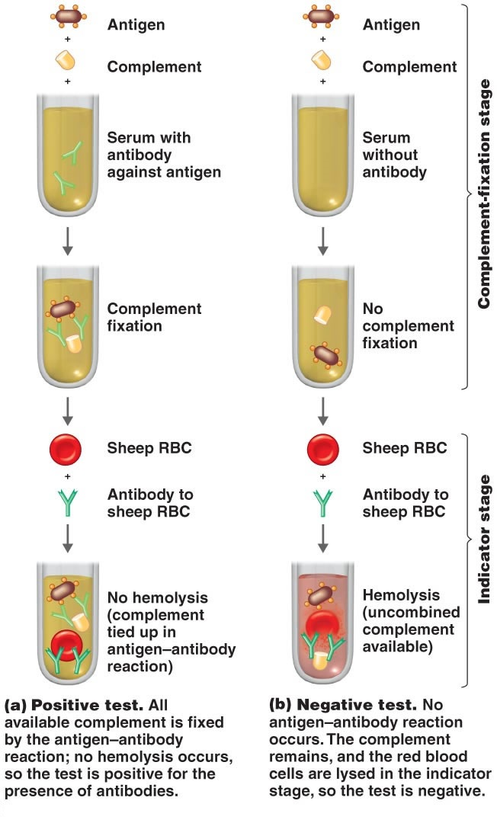

Slide 7
Negative Test
Step 1:
At 37°C
Antigen + Antibody absent + Complement Complement not fixed
1 Hour
Step 2:
At 37°C
Free Complement + Haemolytic system Haemolysis
1 Hour (Test Negative)

Slide 8
Positive Test
Step 1:
At 37°C
Antigen + Antibody + Complement Complement gets fixed
(from serum) 1 Hour
Step 2:
At 37°C
Fixed Complement complex + Haemolytic system No Haemolysis
1 Hour (Test Positive)

Slide 9
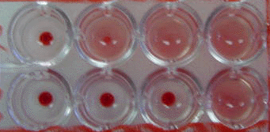
Results and Interpretations:
No haemolysis is considered as a positive test.
haemolysis of erythrocytes indicative of a negative test.
1 2 3 4
A
B
Microtiter plate showing Haemolysis (Well A2, A3,A4 and B4) and No Haemolysis (Well A1,B1,B2 and B4)

Slide 10
References
Sayeed Ismail Khatib
Lecturer
Microbiology & Immunology
Ibn Sina National College for Medical Studies

